Slide 1
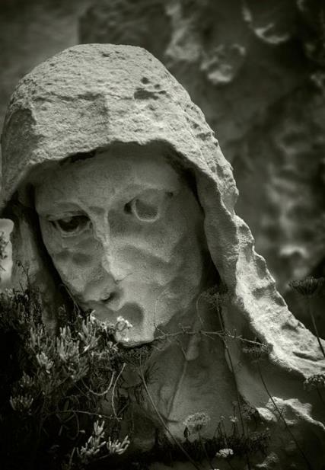
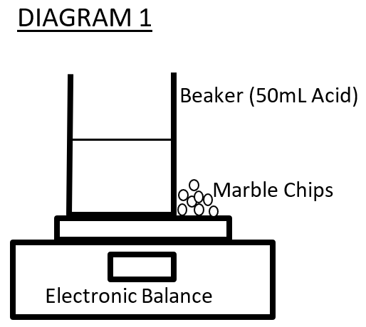
Acid rain and Calcium Carbonate structures
Group Members:
Billy the Kid; Superman; Bilbo Baggins; Albert Einstein
Introduction
Rain which has a pH less than or equal to 5.5 is considered acidic and is called acid rain. Acid rain is caused by pollution released when fossil fuels are burnt – in power stations, cars, and factories. The pollution contains sulphur dioxide and nitrogen oxide gases. In the air, these gases dissolved in water droplets in clouds to form acids. An example is:
SO_{2(g)} + H₂O_{(l)} → H₂SO_{4(aq)}
Sulphur Dioxide + Water → Sulphuric acid
The dissolved acids can be transported long distances by the wind before being deposited in rain. Acid rain can therefore be a significant and widespread problem where industrial and car pollution is not controlled.
It affects freshwater lakes and the wildlife that depend upon them. It also affects trees by harming leaves and soil, and it damages buildings and outdoor statues made of limestone and marble.
Risk Assessment
Table 1: Assessment of risks faced in this experiment
INITIAL: How does acid rain affect statues and building made of limestone?
FINAL: What effect does the concentration of sulphuric acid (from 0.4M to 1.0M) have on the rate of the reaction between sulphuric acid and calcium carbonate granules.
Research Question:
Source of risk | What amount of harm could it cause? | Safety precautions taken | If an incident occurred what should I do?
Sulphuric Acid | Major Injury to eyes and skin | You fill out | You fill out
Marble Chips (calcium Carbonate) | Minor Possible cuts from edges | You fill out | You fill out
Carbon dioxide (produced) | Minor Inhalation can cause death | You fill out | You fill out
Independent variable: Concentration of Sulphuric acid
Dependent variable: Mass loss of the reaction mixture
Independent variables: Volume of sulphuric acid (50mL), Time allowed for the reaction (180 seconds), Temperature of the reactants (25⁰C), Mass of the Marble chips (4 g), Size and shape of the beaker used.
Variables:
Marble and Limestone are both forms of Calcium Carbonate - CaCO₃. Calcium Carbonate is a hard rock like substance which an be sculpted and shaped into statues and blocks for buildings. It reacts with the acid in acid rain. In the equation below, Calcium carbonate is reacting with Sulphuric acid (H₂SO₄), the most common form of acid found in acid rain.
CaCO_{3(s)} + H₂SO_{4(aq)} → CaSO_{4(s)} + H₂O_{(l)} + CO_{2(g)} Calcium Carbonate Sulphuric Acid Calcium Sulphate Water Carbon Dioxide
The only product of the reaction which is a solid - calcium sulphate - is more like a powder than a rock. Therefore, acid rain causes strong structures made from marble and limestone to gradually crumble and erode away. This reaction is generally very slow due to limited amounts of acid rain falling, but the damage accumulates over many years and is irreversible.
Analysis of Data
As the concentration of the acid increases so does the loss in mass. At an acid concentration of 0.4M, the mass loss was 0.19g. At double this concentration (0.8M) the mass loss was 0.38g. As the concentration of acid doubled, so did the mass lost by the marble. This suggests that the best model for acid rain effect is a simple, linear (straight line) relationship between acid rain concentration and the rate of reaction.
However the trend line in graph 1 indicates a more complex relationship. The trend line is curved upwards - meaning at high concentrations of acid, the mass loss was higher than expected from a simple linear model. The curved trend shows that at a concentration of 0.5M a mass loss of just less than 0.2g is predicted. At double this concentration (1.0M), the trend line predicts a mass loss of well over 0.5g - considerably more than double the mass loss predicted by a simple linear model.
This complex relationship suggests that at high concentrations of acid rain there is a much larger than expected increase in the rate of erosion of calcium carbonate structures. Conversely however, it also suggests that decreasing the concentration of acid rain (by reducing pollution) may have greater than expected benefits in reducing the erosion of such structures
Analysis of Errors
There is significant error in the results. There are several points in graph 1 which are not close to the trend line. The data points at 0.6M and 1.0M are close to the trend line; however the data points at 0.4M and 0.5M are not which indicates the trend is not consistent, and not accurate.
The data points also shows that a concentration of 0.5M caused less mass loss (0.18g) than the lower concentration of 0.4M (0.19g). This result contradicts other data points. Therefore the data points do not form a consistent pattern and contain significant error.
These errors are likely random, and caused by poor laboratory technique doing the experiment. The error is likely to be either not making the concentration of the acid accurately, or not stiring the solution and mixing the reactants properly during the three minutes of the reaction.
ANALYSIS
1. Measure 50 mL of sulphuric acid (1.0M) and pour into the beaker.
2. Place the beaker on the electronic scales as shown in Diagram 1 (below).
3. On the electronic scales, beside the beaker add exactly 4 grams of marble chips.
4. Tare (zero) the scales so that the reading is 0.00 g
5. Pick up the Marble chips and add them (all together) to the beaker of Acid. Start the timer at this point. (The mass of the beaker will reduce so a negative mass will show on the electronic balance – this is the mass lost)
6. Stir the solution regularly for the next 3 minutes.
7. At the three-minute mark record the loss in mass of the acid and Marble Chip mixture
8. Discard this mixture and rinse and dry the beaker. You should wash the marble chips thoroughly with water and dry them for reuse
9. Repeat steps 1-7 but using different concentrations of Acid - 0.8M, 0.6M, 0.5M, and 0.4M
Method
Results
The table below records the mass lost from the reaction between Sulphuric acid and the Marble chips after a time period of three minutes.
Table 2: Mass loss after three minutes – Marble chips in Acid
* This data was not used to calculate the average
Concentration of Sulphuric Acid (M) | Mass loss after 3 minutes (g)
 | Trial 1 | Trial 2 | Trial 3 | Average
1 | 0.56 | 0.53 | 0.58 | 0.56
0.8 | 0.36 | 0.37 | 0.41 | 0.38
0.6 | 0.25 | 0.11* | 0.21 | 0.23
0.5 | 0.18 | 0.19 | 0.18 | 0.18
0.4 | 0.19 | 0.2 | 0.19 | 0.19
Graph 1:
The rend line shows the relationship between the concentration of the sulphuric acid and the mass loss of the marble chips. The trend line is curved upwards, showing that the best model for acid rain damage is non-linear and quite complex.
1 x 100 mL beaker 1 x electronic scales Container of marble chips Sulphuric acid (1.0M) 1 x 25 mL Measuring Cylinder Distilled water Watch or timer
Equipment and Materials:
Conclusion
Higher concentrations of acid cause greater mass loss when it reacts with marble. This shows that increased pollution, and higher concentration of acid rain, will cause an increased rate of reaction with Calcium Carbonate structures. The exact relationship was complex and indicated that higher concentrations of acid rain has a greater than expected effect on the Marble. This finding is significant as increases in pollution may have greater than expected effects on Calcium carbonate structures such as statues and buildings.
There was significant error in the investigation and the error appeared to be caused by poor laboratory techniques. Given the degree of error in the investigation this conclusion is not necessarily accurate and further repeated investigation, is recommended.

